Slide 1
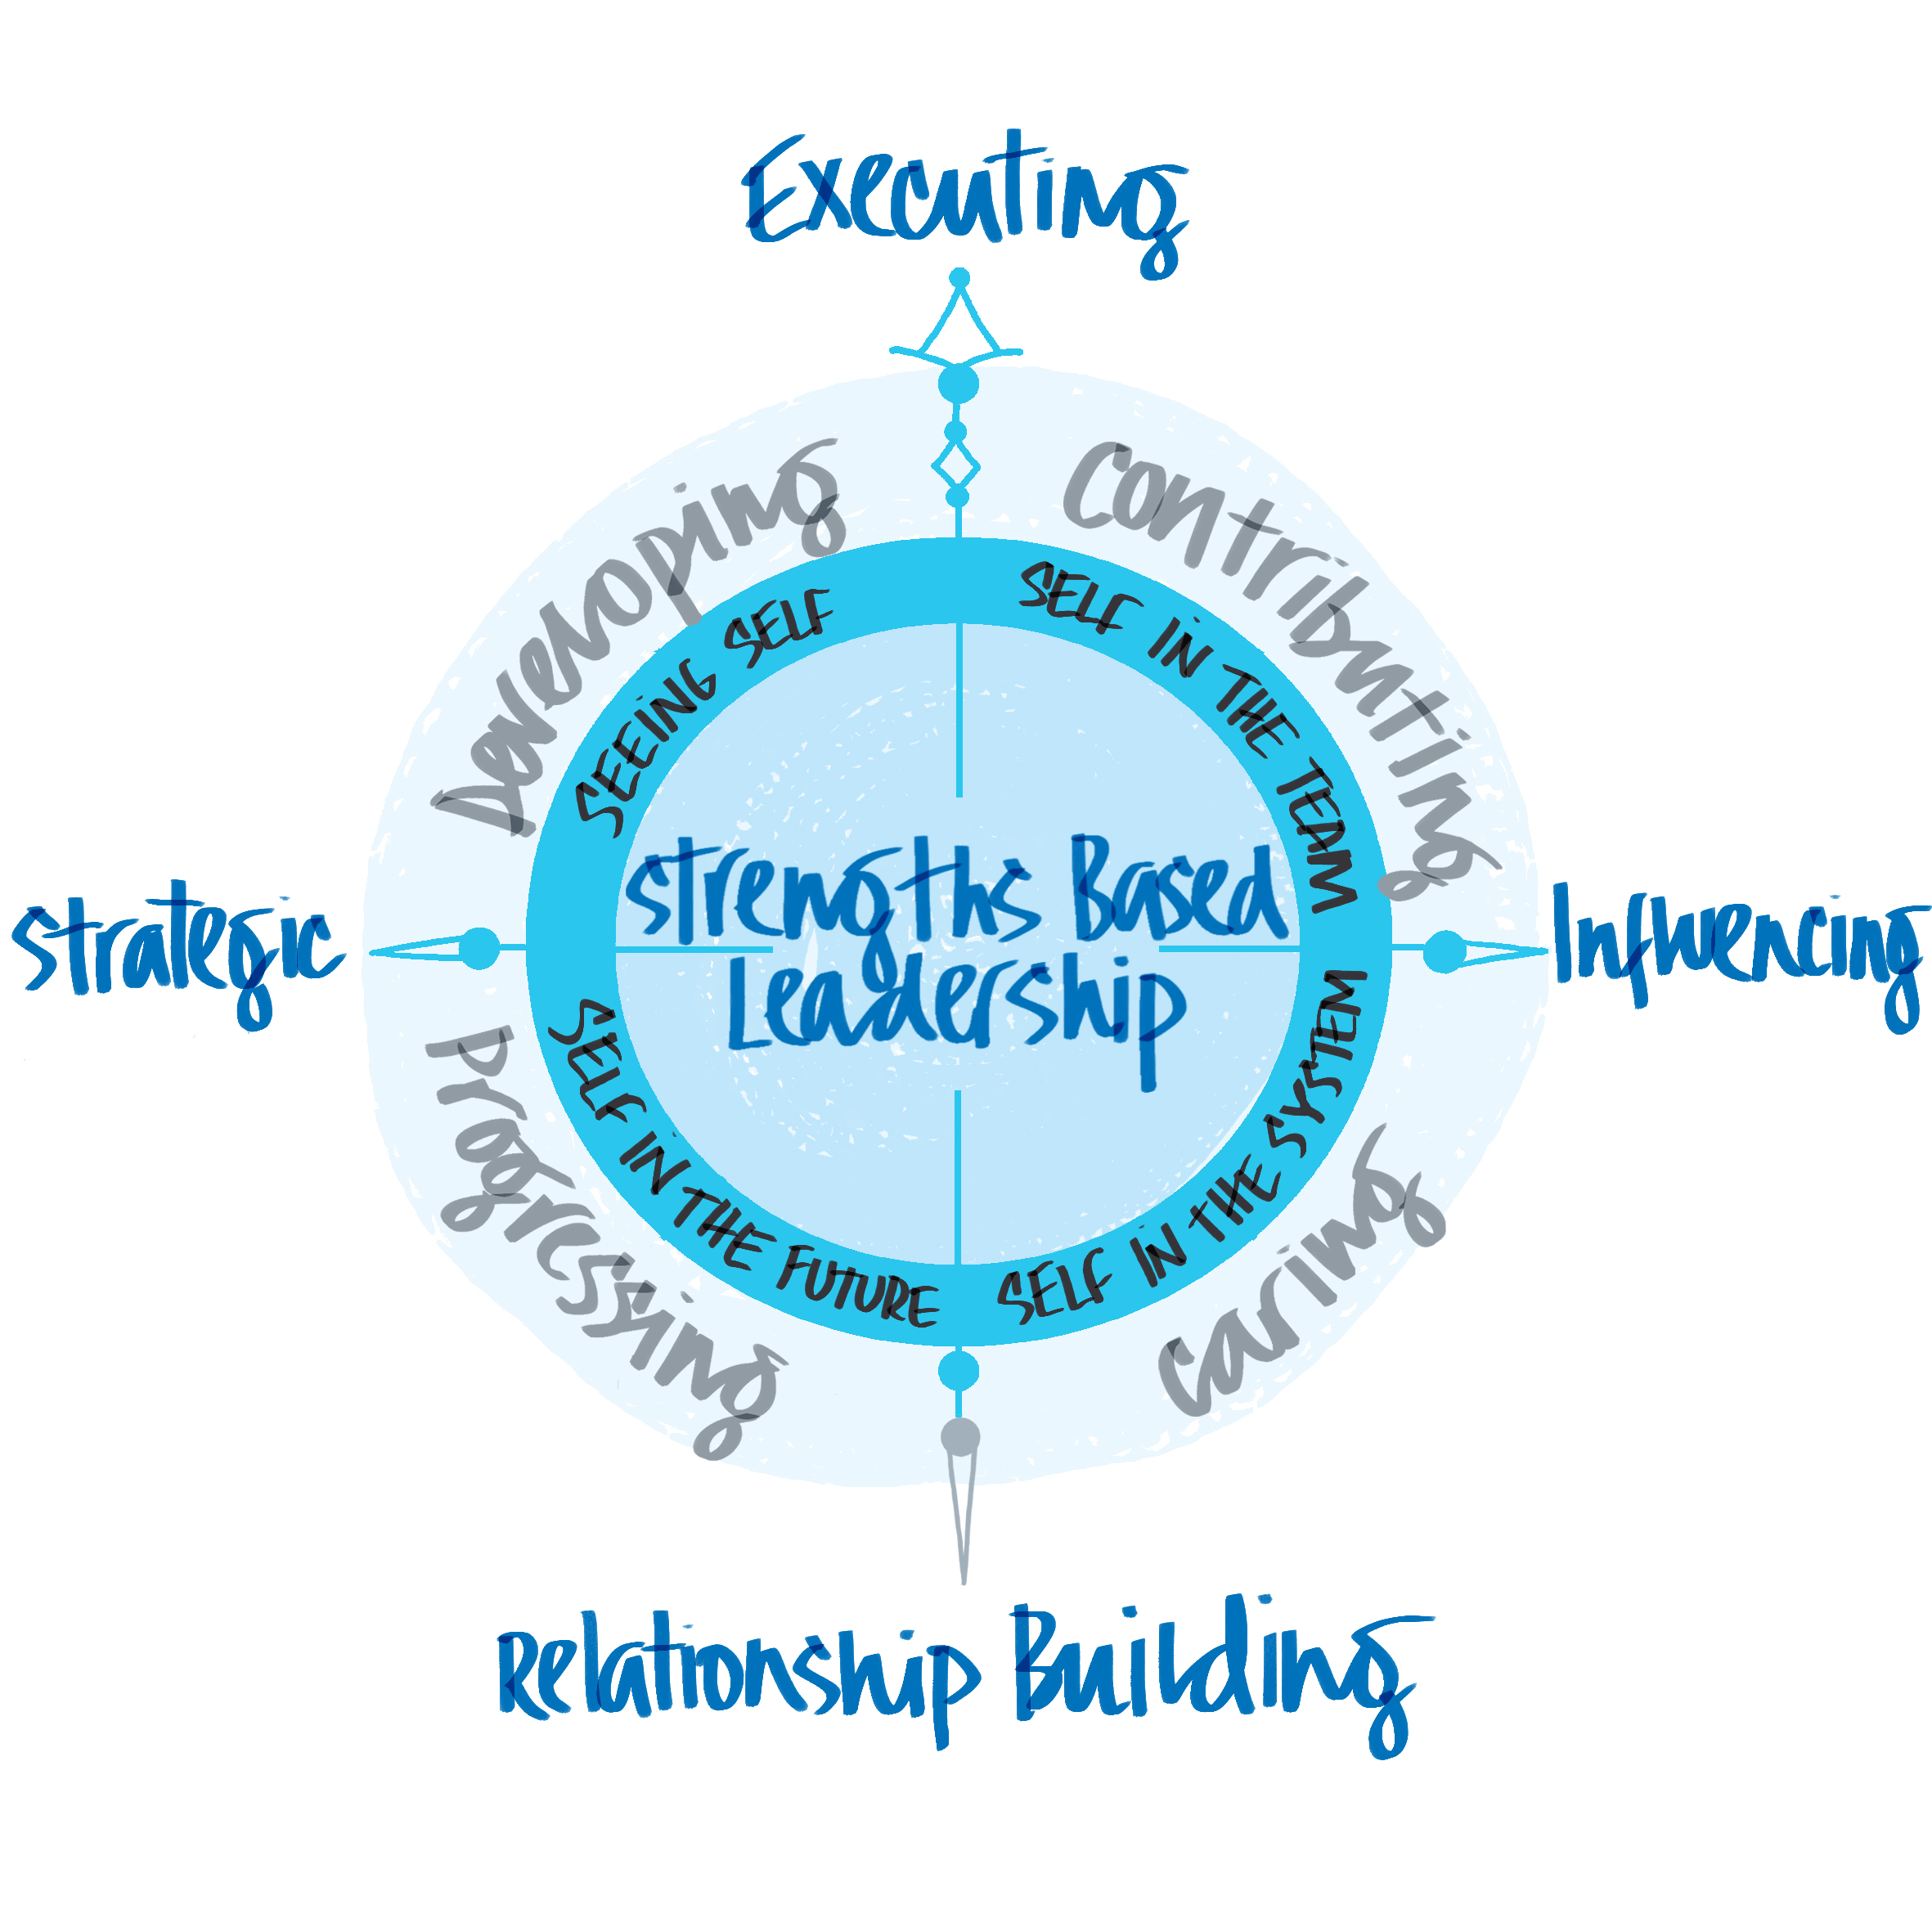
Seeing Self: Strengths
What great leaders have in common is that each truly knows their strengths — and can call on the right strength at the right time.
Tom Rath.

Slide 2
Learning Intentions
Co-create a Thinking Environment by using the rules of Engagement.
Re-convene as a learning group.
Review and crystallise significant learning from How Full is Your Bucket book.
Define the 4 strengths domains.
Explore your personal strengths and support others to do the same, maximising impact.
Plan to complete a Strengths Development Plan with your Thinking Partner, using the Thinking Environment framework.

Slide 3
How Full is your Bucket
What has been the most significant impact of reading the ‘Bucket Book’?

Slide 4
Executing CP/A | Influencing A/NP/NC | Relationship Building NP/A | Strategic Thinking A/NC/CP
Achiever Arranger Belief Consistency Deliberative Discipline Focus Responsibility Restorative | Activator Command Communication Competition Maximiser Self – Assurance Significance Woo | Adaptability Developer Connectedness Empathy Harmony Includer Individualisation Positivity Relator | Analytical Context Futuristic Ideation Input Intellection Learner Strategic
Values driven and goal focussed, EXECUTORS get stuff done. They are responsible problem solvers, planners and pragmatists. | Energy driven and engagement focussed, INFLUENCERS sell ideas and opportunities. They are promoters, connectors, communicators and believers. | Team driven and people focussed, RELATIONSHIP BUILDERS get others involved. They are coaches and mentors, empathic and caring. | Future driven and decision focussed, STRATEGIC THINKERS drive and deliver change. They are creatives, learners, analysts and doers.

Slide 5
Connecting to Strengths
In your pairs take 15 minutes each way to share your top 5 strengths
with each other.
How do your strengths connect to your role and to the universal behaviours.
Remember to listen without interrupting.

